Slide 1

Trust Activities 2018 / 19

Slide 2
AFT Biologists Report
Adult salmon abundance; conservation regulations
Juvenile populations; electrofishing, NEPS
Smolt projects; Marine Survival & Migration
Local marine pressures; Aquaculture
Freshwater Habitat; Habitat, Water Temperature & Nutrient projects
Other activities;
Contracts
Outreach

Slide 6
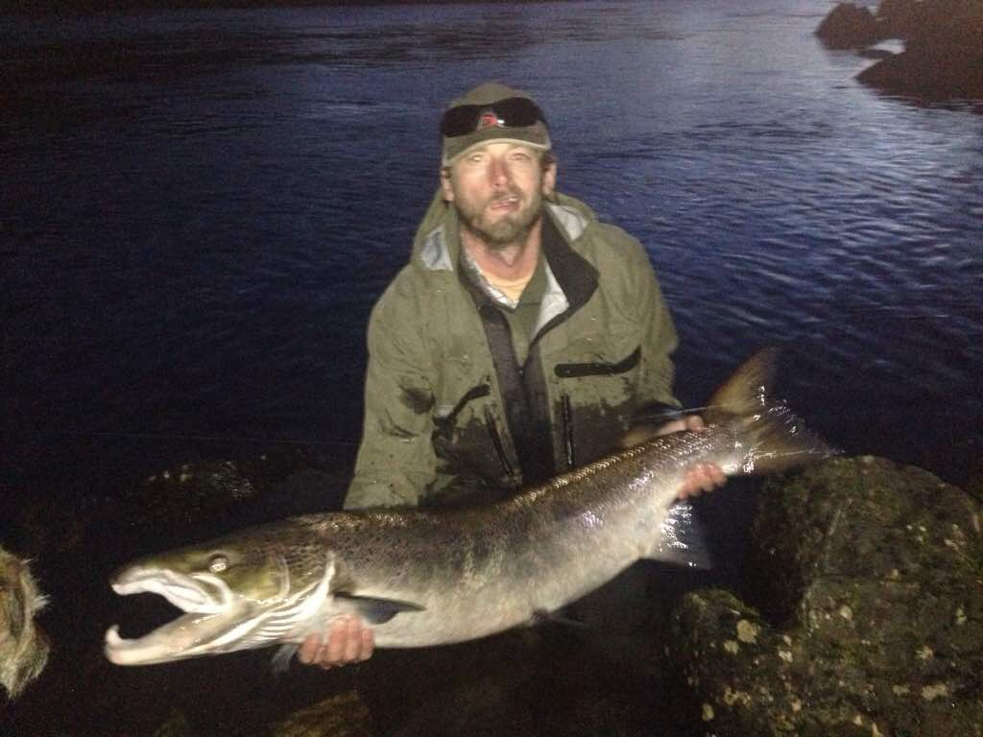
Conservation limits
Salmon Conservation Limits set by Marine Scotland Science
All Argyll mainland Grade 3 based on;
Counter data (Amalgamated), Fishery exploitation (too low)
Egg deposition (estimate), Fecundity (unknown)
Size of catchment (under review), Grilse error (unknown)
Sex ratio (unknown), River Flows (to be confirmed)
AFT committed resources to provide electrofishing data

Slide 7
Conservation limits 2019
Category | Probability of Meeting CL | Advice | No. Rivers
1 | At least 80% | Exploitation is sustainable therefore no additional management action is currently required. This recognises the effectiveness of existing non-statutory local management interventions. | 1
2 | 60-80% | Management action is necessary to reduce exploitation: catch and release should be promoted strongly in the first instance. The need for mandatory catch and release will be reviewed annually. | 3
3 | Less than 60% | Exploitation is unsustainable therefore management actions required to reduce exploitation for 1 year i.e. mandatory catch and release (all methods). | 23

Slide 8
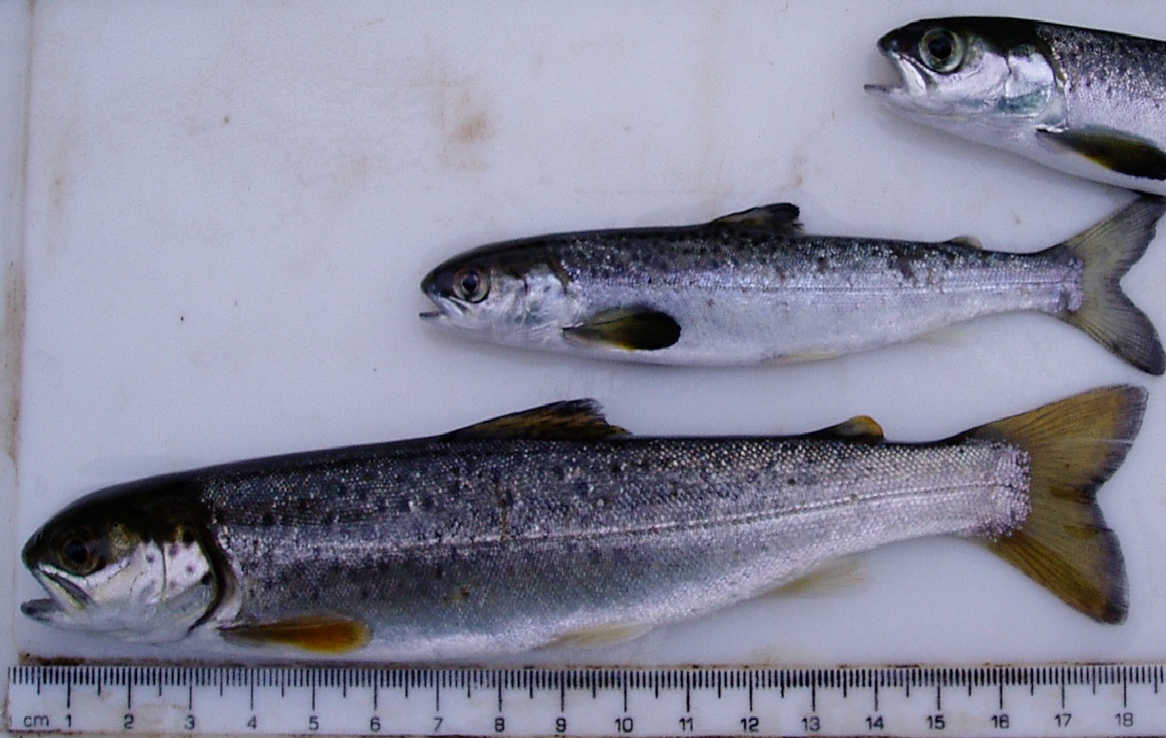
Post-smolt sea survival

Slide 9
Post-smolt sea survival
Sea trout sea lice burdens (FMS); Sampling at 5 sites annually in spring
Sea survival of salmon smolts (PIT Tagging) on River Awe ; 2016-19 > 7,000 smolts tagged
West Coast Smolt Tracking; Potential for smolt migration tracking through inshore waters

Slide 10
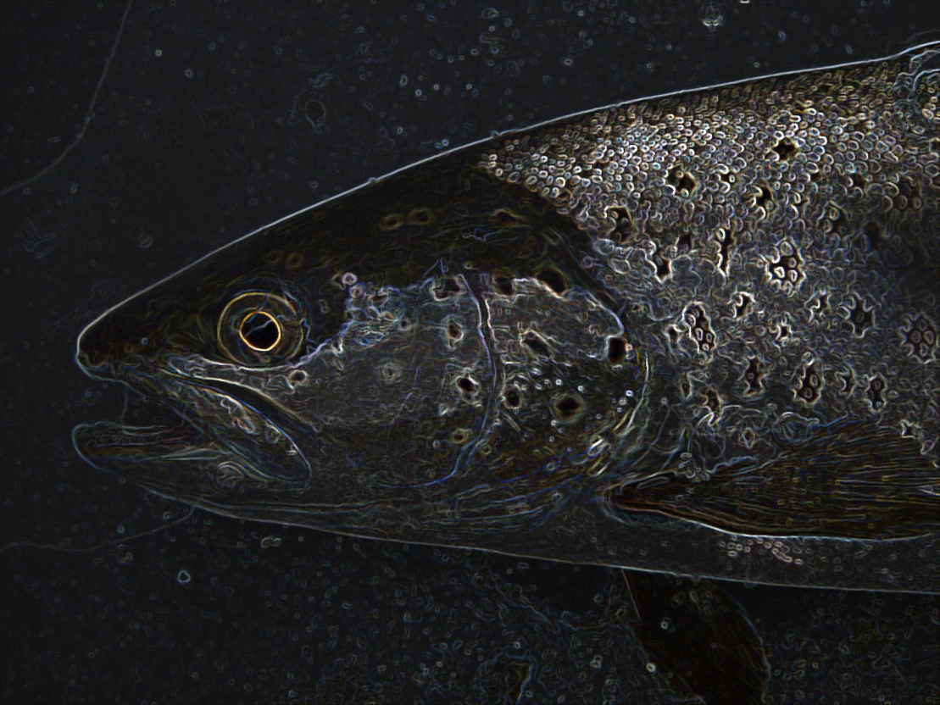
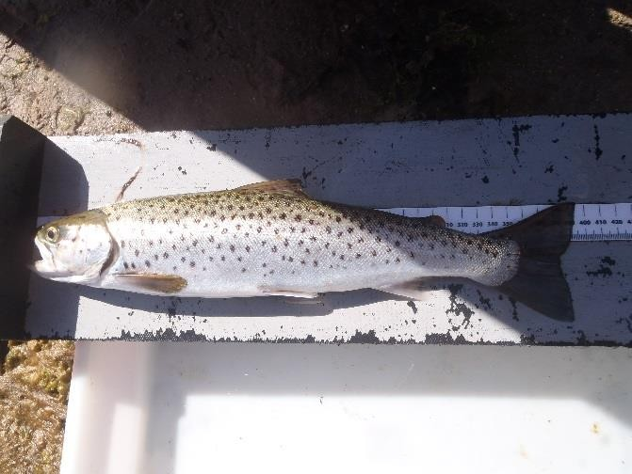
Sea lice surveys 2019
Notes:
Rivers and Fisheries Trusts of Scotland (RAFTS), freshwater conservation charity representing Scotland’s national network of rivers and fisheries Trusts and Foundations. RAFTS manages a range of core policy and project-driven objectives.
Tried to establish a new site at Southend. Conditions not suitable. Possibility of new site on east side of south loch fyne.

Slide 11
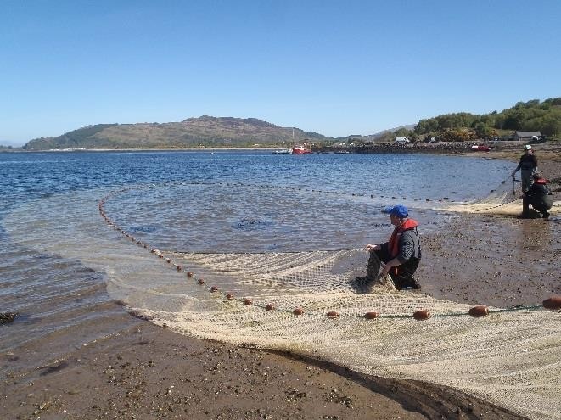
Sea lice surveys 2019
Notes:
Rivers and Fisheries Trusts of Scotland (RAFTS), freshwater conservation charity representing Scotland’s national network of rivers and fisheries Trusts and Foundations. RAFTS manages a range of core policy and project-driven objectives.
Tried to establish a new site at Southend. Conditions not suitable. Possibility of new site on east side of south loch fyne.

Slide 12
Sea lice surveys 2019
Notes:
Rivers and Fisheries Trusts of Scotland (RAFTS), freshwater conservation charity representing Scotland’s national network of rivers and fisheries Trusts and Foundations. RAFTS manages a range of core policy and project-driven objectives.
Tried to establish a new site at Southend. Conditions not suitable. Possibility of new site on east side of south loch fyne.

Slide 13
Sea lice surveys 2018
Notes:
Rivers and Fisheries Trusts of Scotland (RAFTS), freshwater conservation charity representing Scotland’s national network of rivers and fisheries Trusts and Foundations. RAFTS manages a range of core policy and project-driven objectives.
Tried to establish a new site at Southend. Conditions not suitable. Possibility of new site on east side of south loch fyne.

Slide 14
Dunstaffnage; Intensity of Sea lice infection 2002-2019
Notes:
Rivers and Fisheries Trusts of Scotland (RAFTS), freshwater conservation charity representing Scotland’s national network of rivers and fisheries Trusts and Foundations. RAFTS manages a range of core policy and project-driven objectives.
Tried to establish a new site at Southend. Conditions not suitable. Possibility of new site on east side of south loch fyne.

Slide 15
Loch Fyne; Intensity of Sea lice infection 1999-2018
Notes:
Rivers and Fisheries Trusts of Scotland (RAFTS), freshwater conservation charity representing Scotland’s national network of rivers and fisheries Trusts and Foundations. RAFTS manages a range of core policy and project-driven objectives.
Tried to establish a new site at Southend. Conditions not suitable. Possibility of new site on east side of south loch fyne.

Slide 16
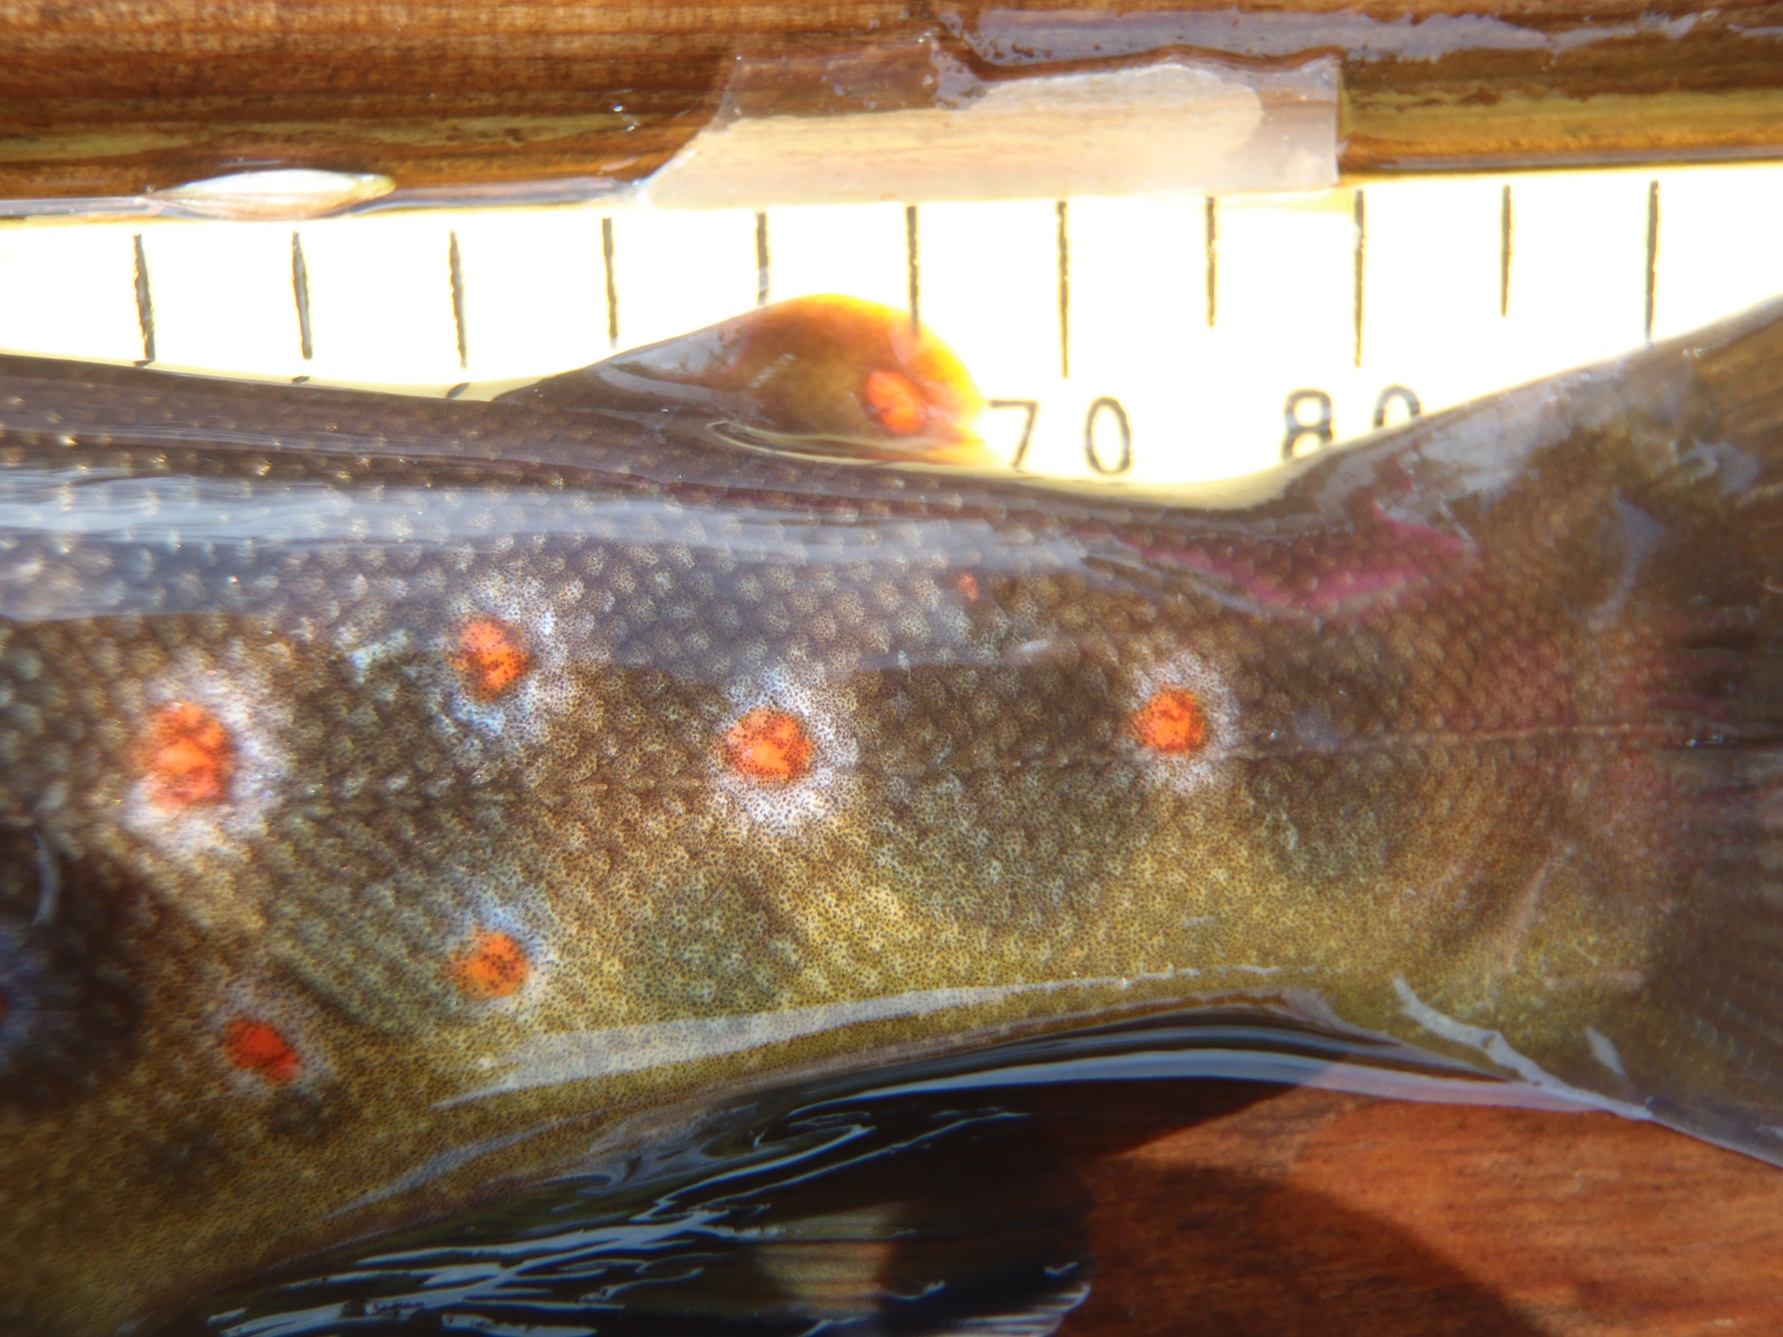
juvenile fish surveys 2019

Slide 17
juvenile surveys 2019
Awe / Orchy
Ruel
Loch Fyne
Creran
Contracts; River Forsa (Mull)
NEPS 2019

Slide 18
NEPS 2019
Awe
Mid-Argyll; Nell & Add
Loch Fyne; River Aray
South; Goil, Eachaig & Ruel
Kintyre; Carradale & Barr Water
Arran; Iorsa
Mull; River Forsa, Ba, Coilador, Bellart
Islay; Laggan, Sorn & Kintour

Slide 19
NEPS 2019

Slide 20
NEPS 2019

Slide 21
NEPS 2019

Slide 22
NEPS 2019

Slide 23
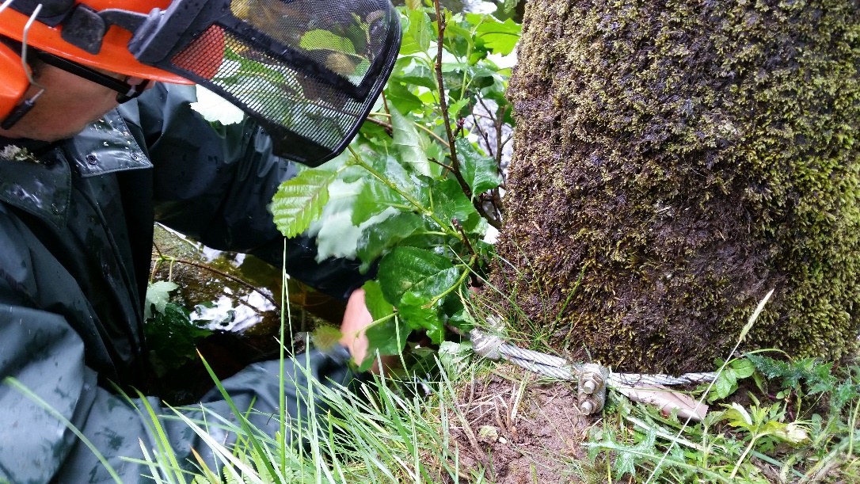
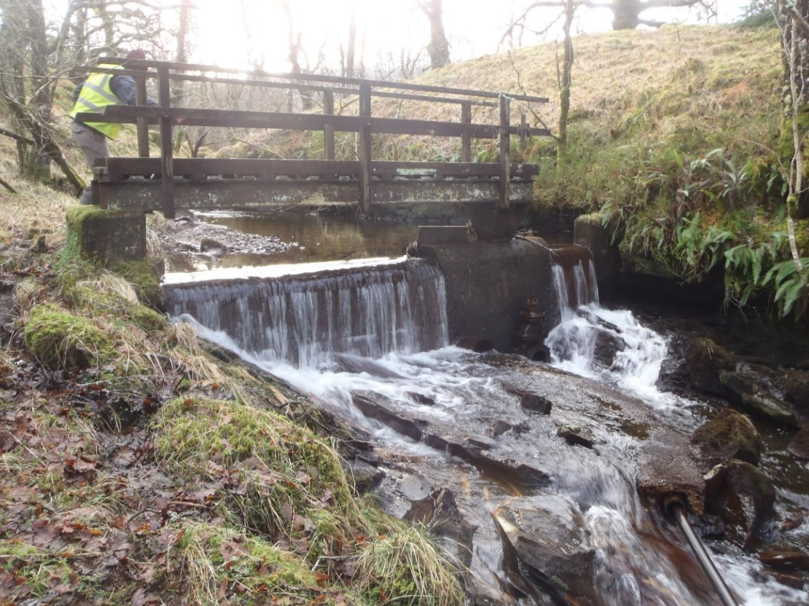
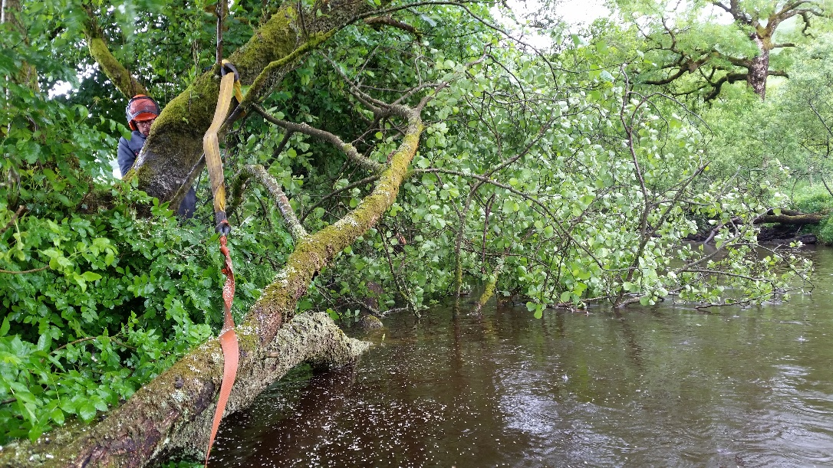
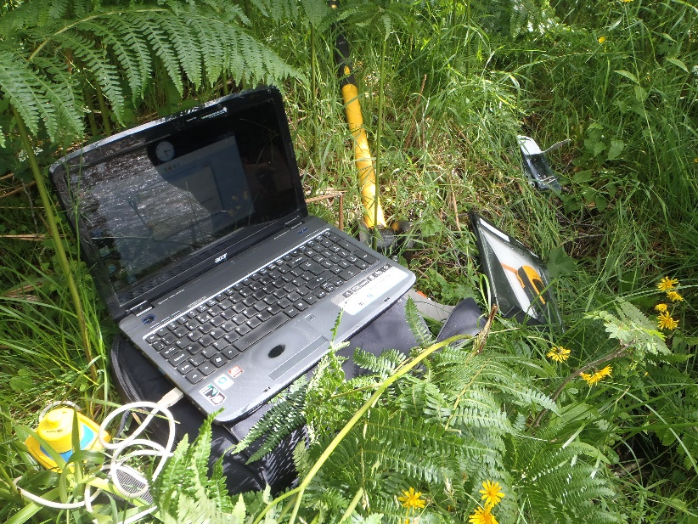
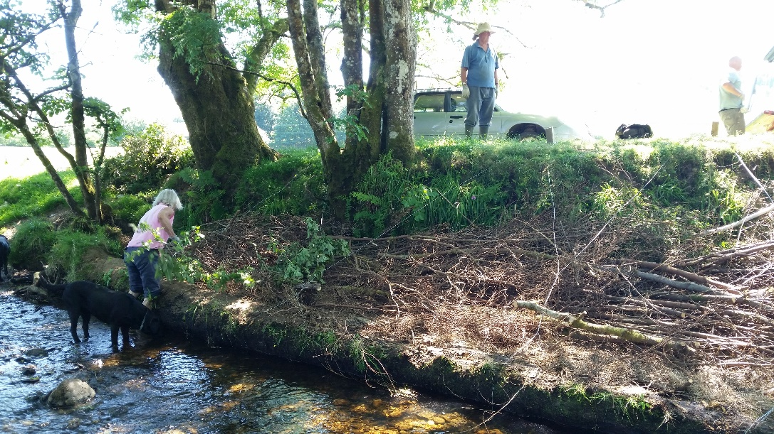
FRESHWATER HABITAT 2019

Slide 24
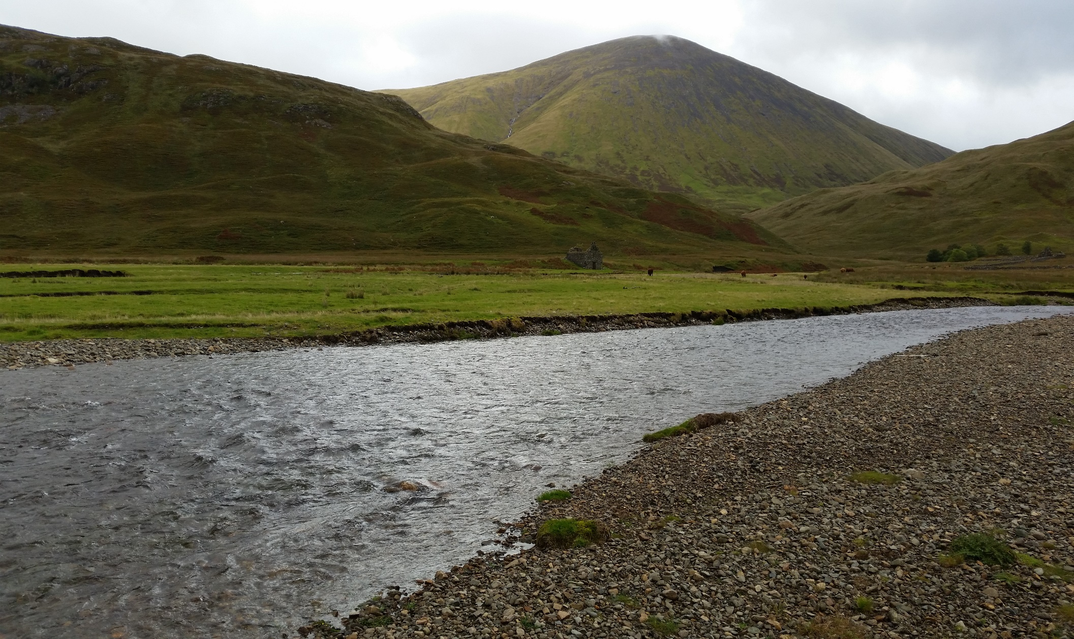
Increasing fry production;
Nutrient project

Slide 25
Increasing fry production;
Nutrient project
Decrease in nutrient export from marine sources; fish carcasses
Low productivity catchments
Land-use
Addition of nutrients (spring 2019)
Fry sampling (summer 2019)
Water of Tulla
R. Creran
River Fyne / R. Kinglas

Slide 26
Water of Tulla;
Nutrient project

Slide 27
River Creran;
Nutrient project

Slide 28
AFT Summary
Unprecedented decline in numbers of wild Atlantic salmon in recent years.
Survival at sea may improve with next cooling phase (AMO) ; Food availability, competition & predation
Aquaculture Sea lice / escapes remain as potential threats; Drivers for Environmental Monitoring Plans
In-river juvenile populations have declined but have capacity to recover; monitoring & reporting required
Future focus; Informing agencies, developing EMPs & maximising smolt production and survival

Slide 29
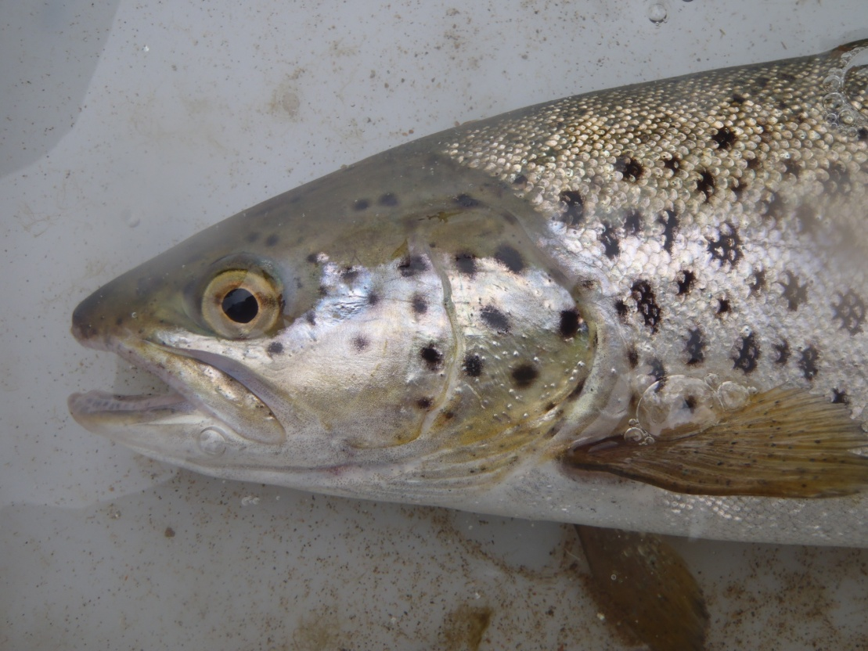
Thank you for your support
Notes:
Rivers and Fisheries Trusts of Scotland (RAFTS), freshwater conservation charity representing Scotland’s national network of rivers and fisheries Trusts and Foundations. RAFTS manages a range of core policy and project-driven objectives.
Tried to establish a new site at Southend. Conditions not suitable. Possibility of new site on east side of south loch fyne.

