Slide 1

AFT Biologist’s Report
AFT AGM Nov, 2023

Slide 2
AFT Activities 2023-24
West Coast Salmon Smolt Tracking Project (SG, SS, AST & FMS)
Awe Barrage Smolt Tracking Pilot Study (ADRIA/SSE)
River Habitat Improvement Works (Project funding)
Informing Salmon Conservation Limits: ASSES / NEPS / FMPs - (MD & FMS)
Monitoring sea lice burdens of Sea trout (EMPs & FMS)
Surveys undertaken to inform development projects & Fishery Management (Commercial contracts)
Consultation & Representation (AFT & Argyll DSFB)

Slide 3
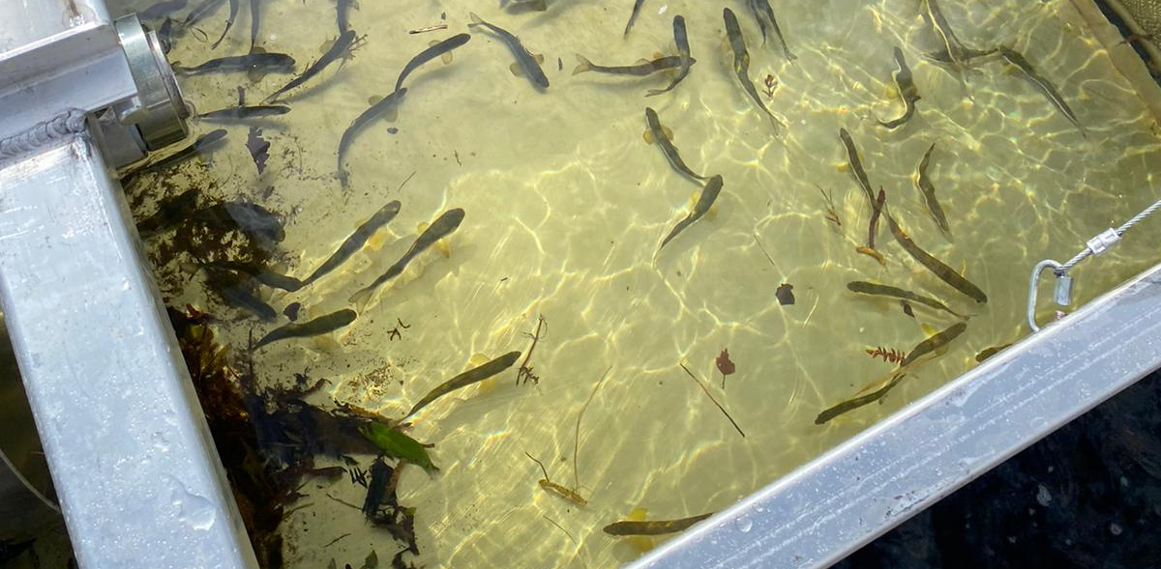
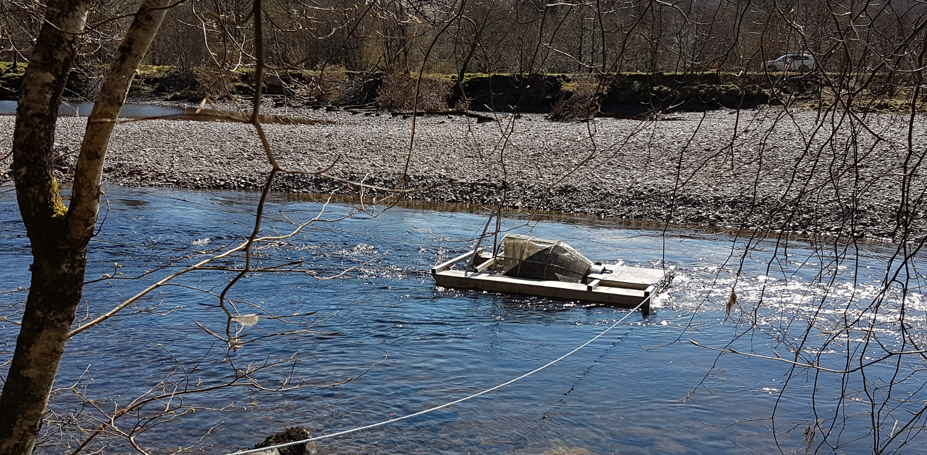
West Coast Salmon Smolt Tracking Project
Identify inshore marine routes & timing of salmon smolt migration
Inform policy on marine development of aquaculture & renewable energy projects
AST, SG, SS & FMS Funded
2023 – 3rd of 3-year project (April & May)
900+ smolts tagged per year across the west coast
666 Argyll Smolts >130mm tagged & released 2021-23
Receivers deployed at river mouth & throughout west coast

Slide 4
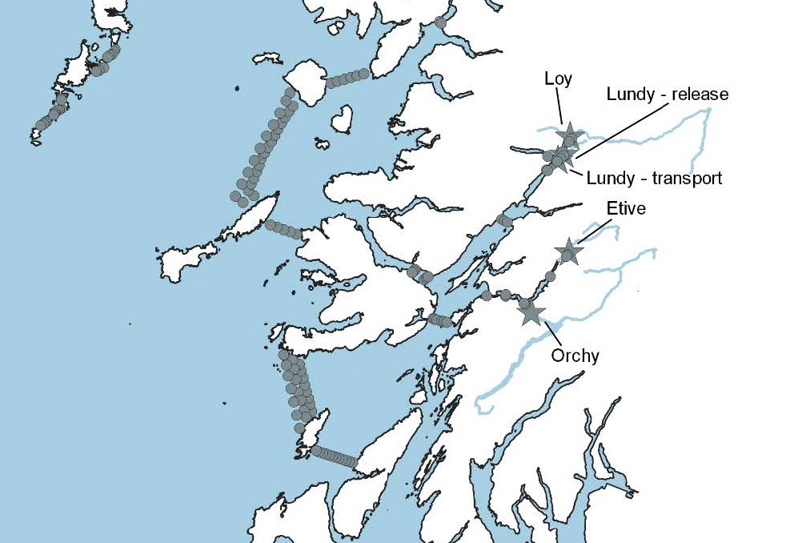
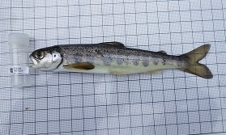
West Coast Salmon Tracking Project 2021-23
Awe & Etive catchments
2021 – 200 smolts
2022 – 226 smolts
Awe & Fyne catchments
2023 – 240 smolts
Changes in Receiver Array with emphasis on Sound of Mull & Firth of Lorn
Time spent in migration important to new Sea Lice Framework
Future studies to be developed

Slide 5
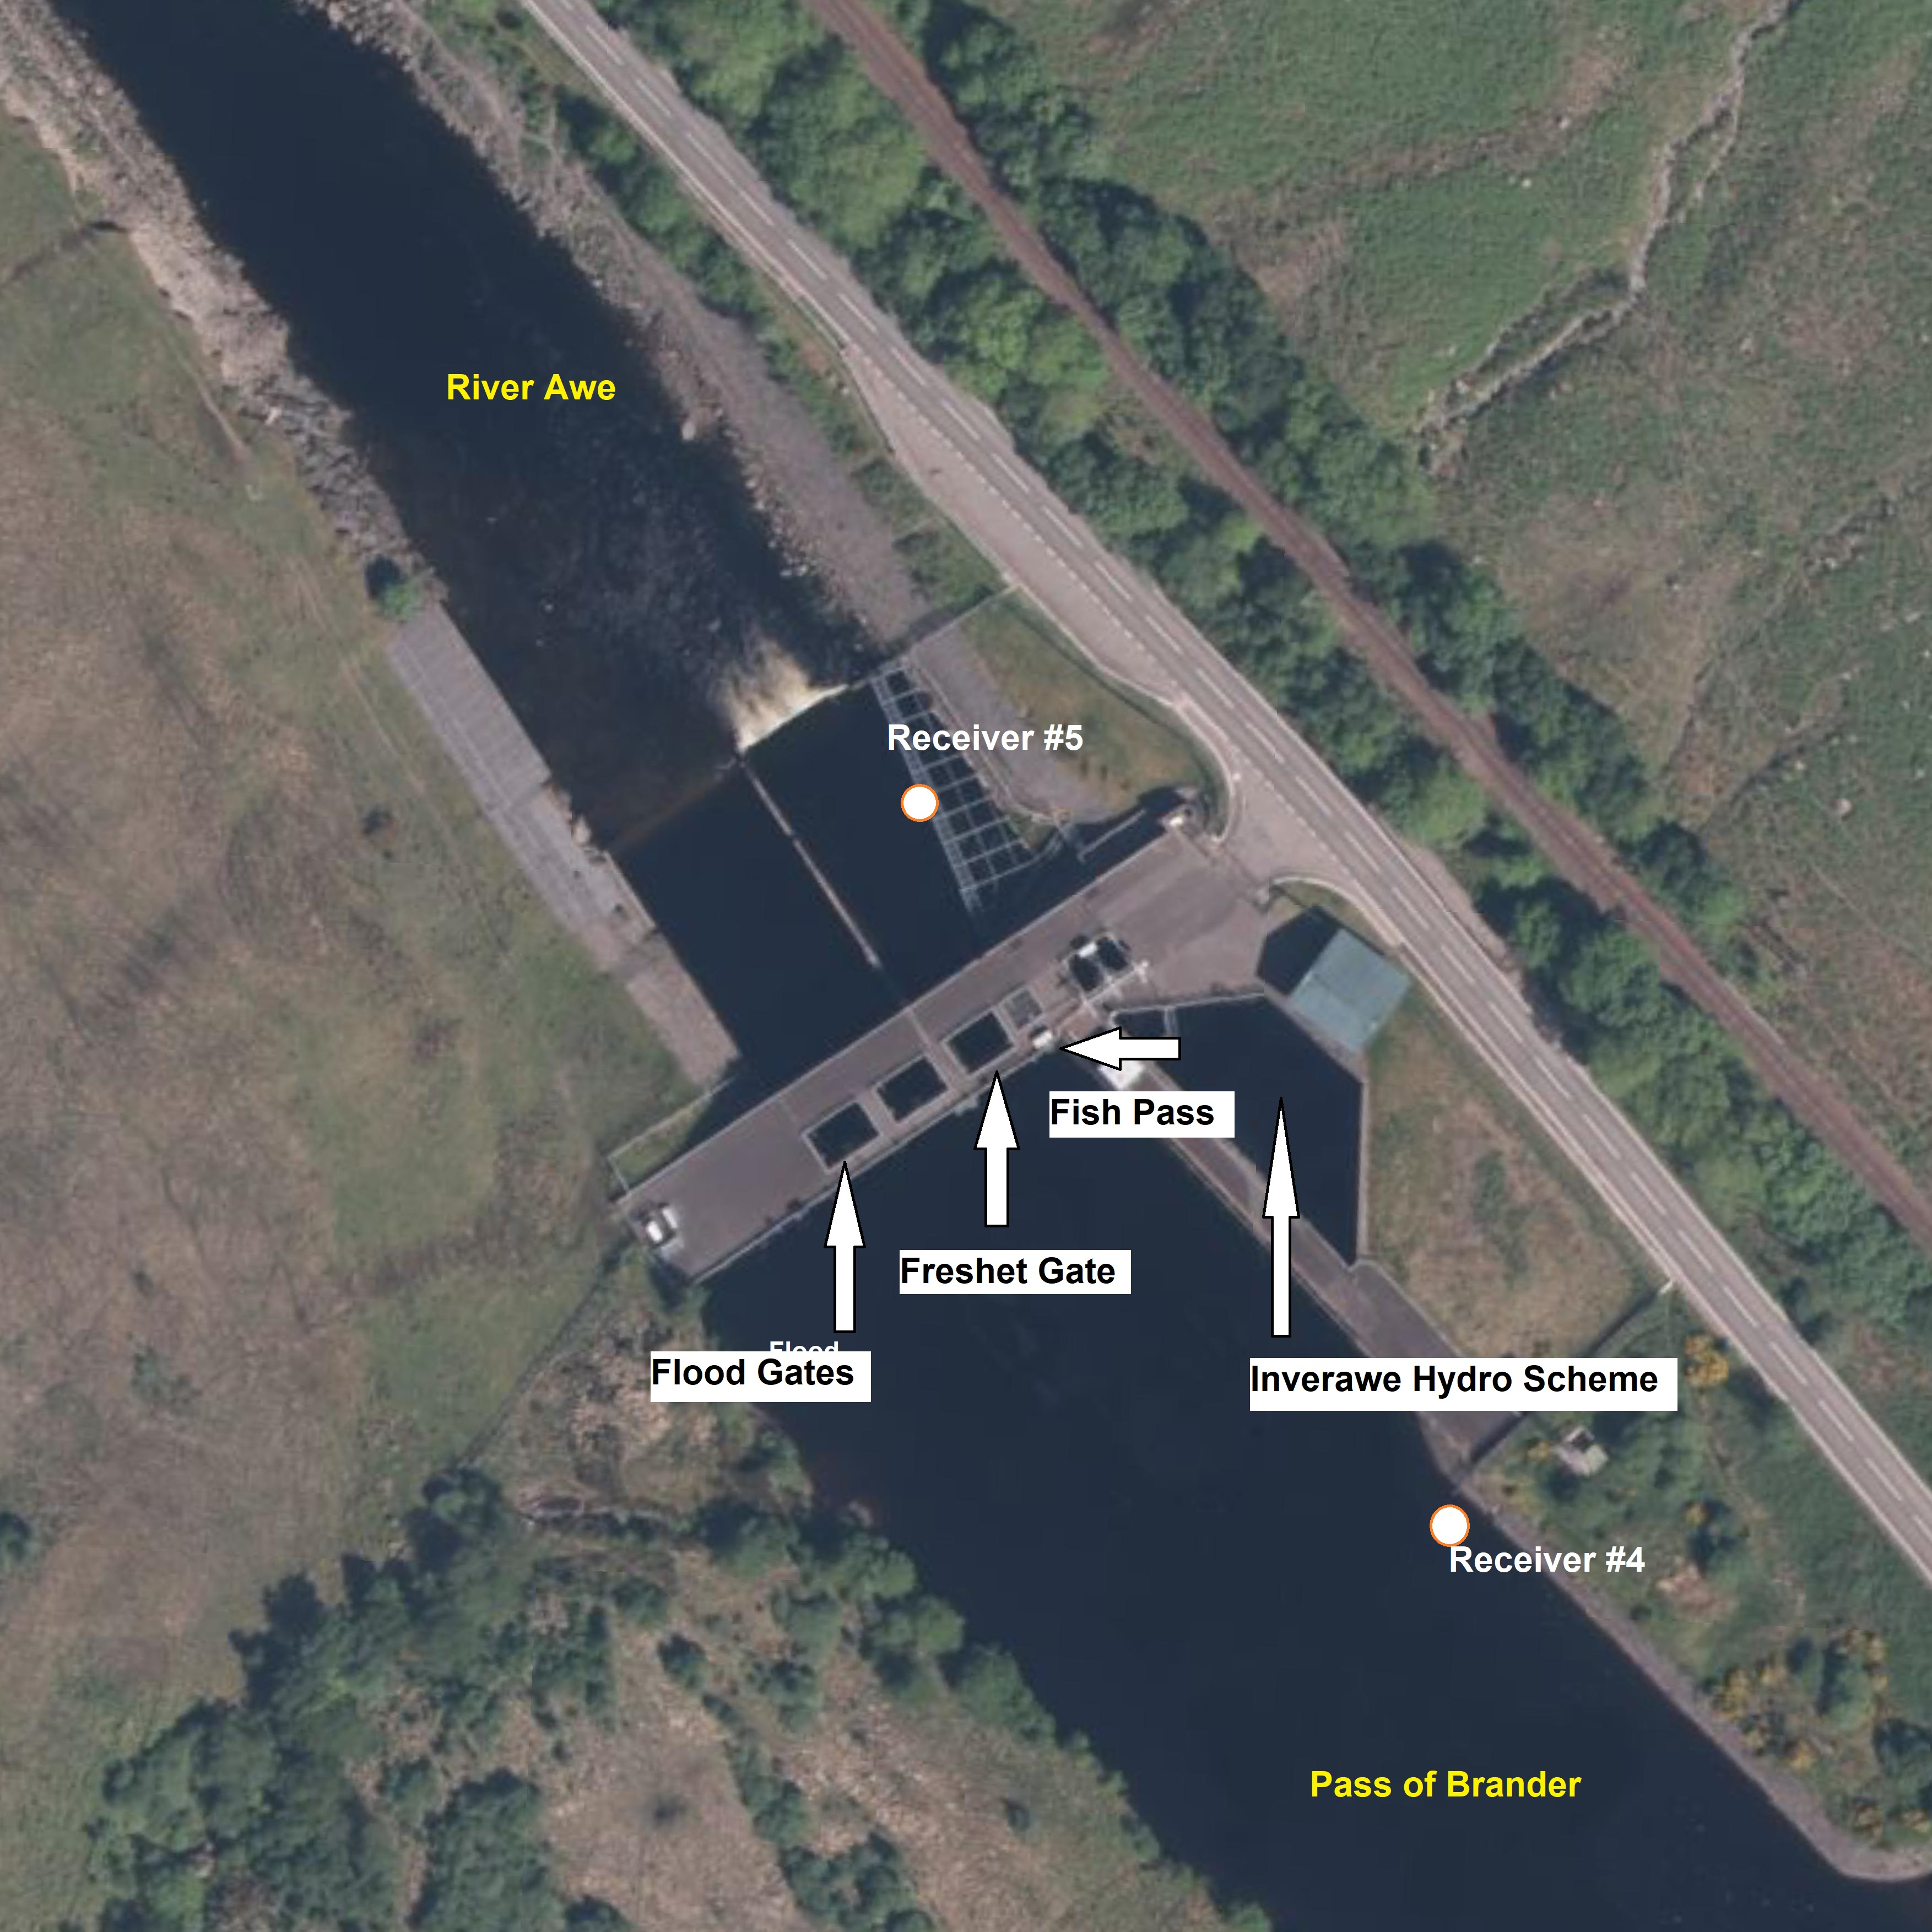
River Awe downstream fish migration
- Pilot Acoustic tracking Study 2022-23
Identify issues for downstream migration in relation to hydroelectric generation at Inverawe
26 smolts tagged & released upstream of barrage in 2022
50 smolts tagged & released in 2023
2023 included 10 % predator tags.
7 ferox trout also tagged in 2022-23
Currently processing 2023 results

Slide 6
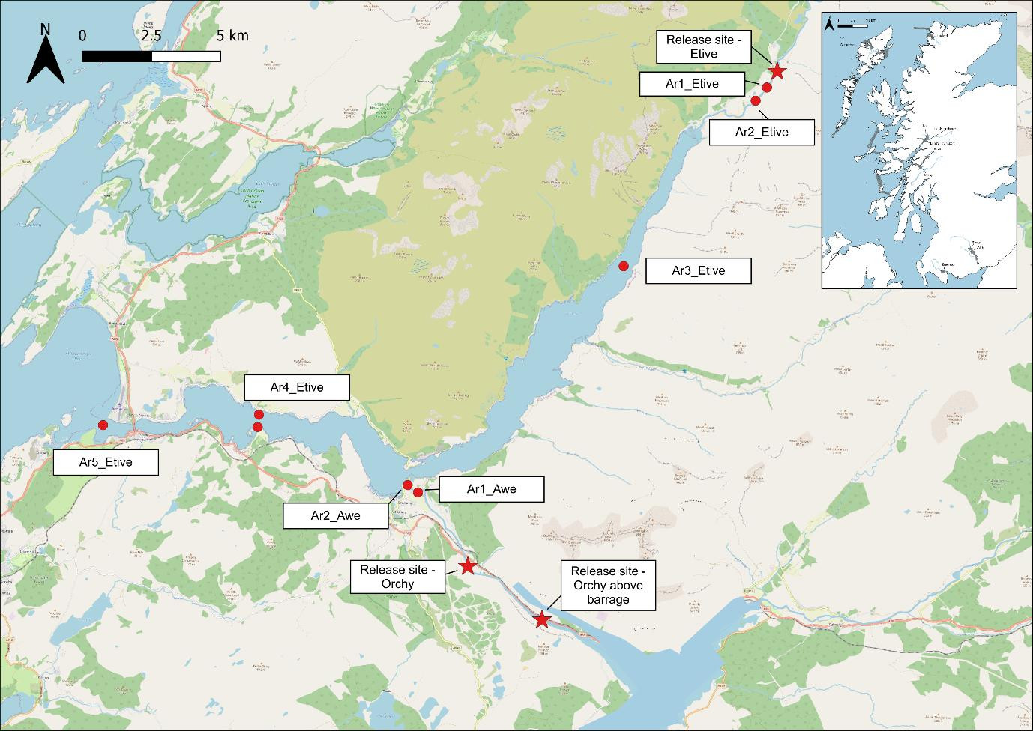
WCST Project – 2022 Inshore Results
Leaving the river (detected)
Orchy DSB - 79 % (4.3 days)
Orchy USB – 35 % (8.2 days)
Etive – 90 % (3.0 days)
During night hours
Leaving Loch Etive (detected)
Orchy DSB – 74 % (4.4 days)
Orchy USB – 23 % (6.2 days)
Etive - 80 % (6.9 days)
During night & daylight hours

Slide 7
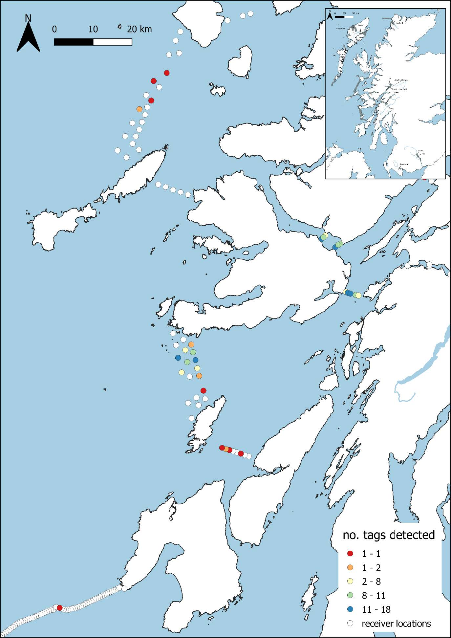
WCST Project – 2022 Orchy Marine Results
DSB Orchy (123 tags)
Marine - 65 % (80 smolts)
Sound of Mull – 12 % (15)
Coll – Rum – 3.3 % (4)
Firth of Lorn – 53 % (65)
Jura – Colonsay – 1.6 % (2)
Colonsay – Mull – 51 % (63)
Islay – Malin – 0.8 % (1)
USB Orchy (26 tags)
Marine - 15 % (4 smolts)
Sound of Mull – 3.9 % (1)
Loch Linnhe – 3.9 % (1)
Firth of Lorn – 11.5 % (3)
Colonsay – Mull – 7.7 % (2)

Slide 8
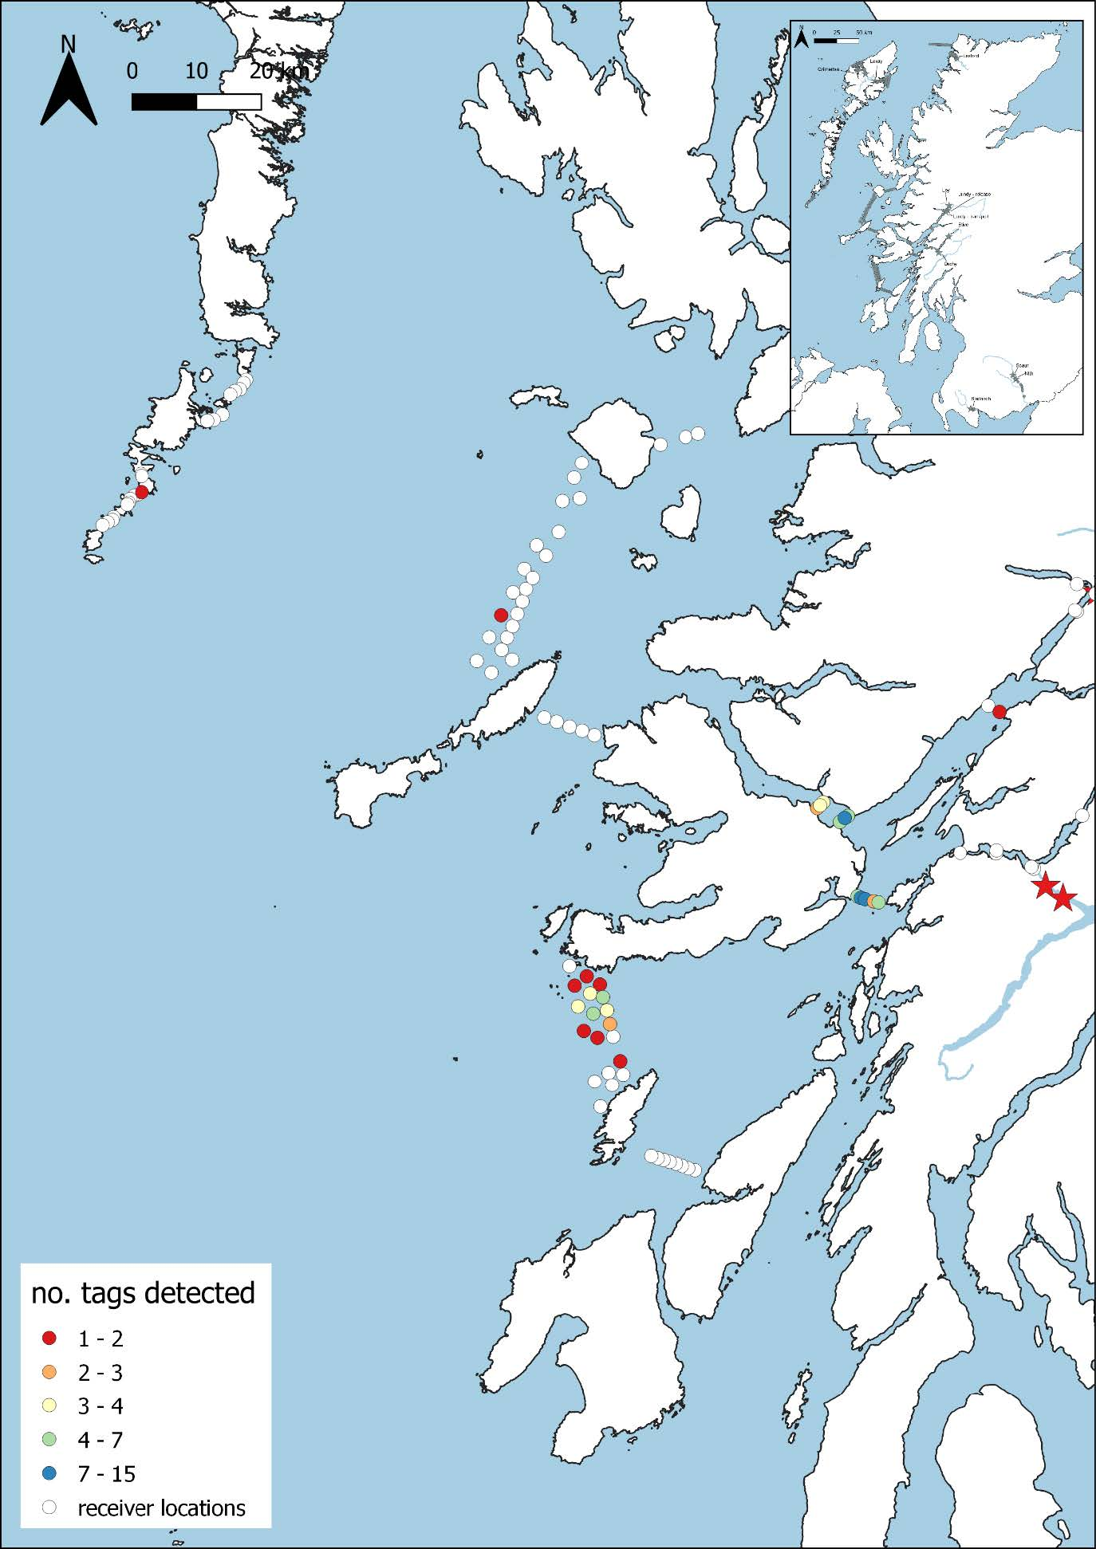
WCST Project – 2022 Etive Marine Detections
Etive - 77 tags
Marine - 75 % (58 smolts)
Sound of Mull – 13 % (10)
Coll – Rum – 1.3 % (1)
Firth of Lorn – 61 % (47)
Colonsay – Mull – 39 % (30)
Outer Hebrides – 1.3 % (1)
Total -226 tags
Marine - 63 % (142 smolts)
Sound of Mull – 11.5 % (26)
Coll – Rum – 2.1 % (5)
Firth of Lorn – 51 % (115)
Jura – Colonsay – 0.9 % (2)
Colonsay – Mull – 42 % (95)
Islay – OH – 0.9 % (2)

Slide 9
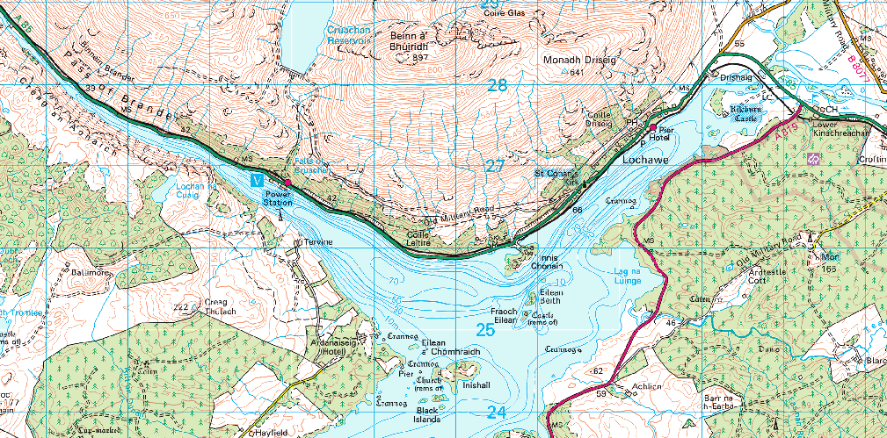
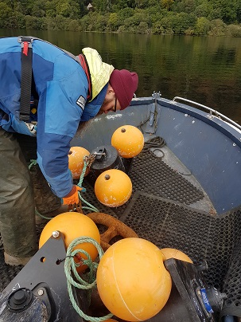
River Awe downstream fish migration Study 2024-2026
Proposals - AFT are in negotiations with SSE to design and implement further study of salmon smolt migration in the Awe catchment:
Provide funding support over a 3-year study
Smolt migration (timing / duration / survival) through Loch Awe & River Awe / Inverawe hydro scheme.
Understand environmental factors affecting migration and fine tune operation of the Awe barrage to maximise smolt passage & survival.
Understand any effect of pump-storage hydro scheme on smolt migration

Slide 10
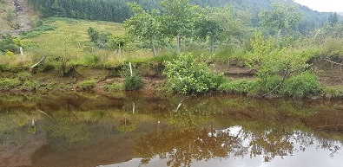
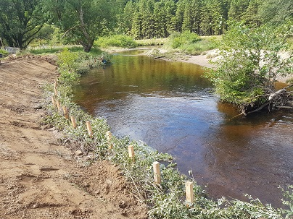
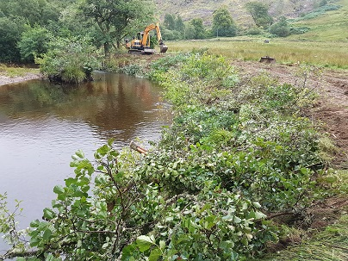
Habitat Improvement – River Goil
6th Year of on-going habitat project
Reduce bank erosion & improve bed condition using green bank revetment
Increase riparian vegetation by fencing & tree planting
£10K+ funding from Lomond & Trossachs National Park 2023-24
Loch Goil Community Trust volunteers
Tracked digger & dumper to increase productivity & reduce manual work

Slide 11
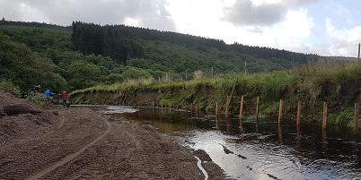
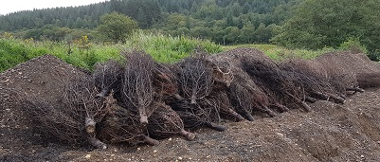
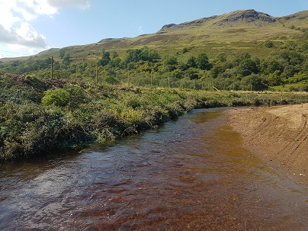
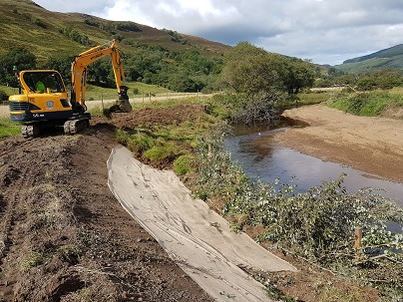
Habitat Improvement – River Ruel
Combination of GBR & LWD –reducing fine sediment in the riverbed
£12+K project in 2023
Wild Fisheries Fund
River Ruel Improvement Association
Scottish & Southern Energy
Cruach Wind Farm Trust

Slide 12
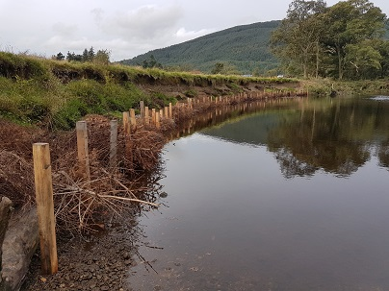
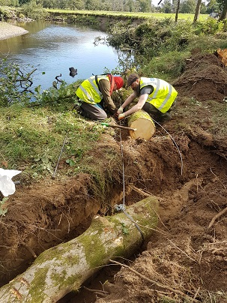
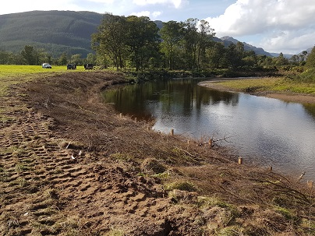
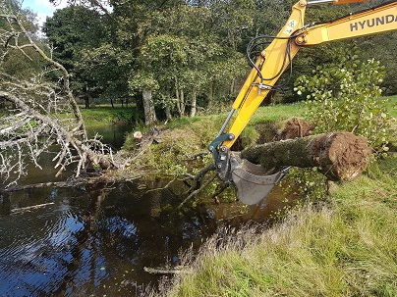
Habitat Improvement – River Eachaig
Bells Pool
£11K+ - Wild Fisheries Fund / LLTNP / Eachaig Fishery
Green bank revetment
Coarse Woody debris
Repairs required!

Slide 13
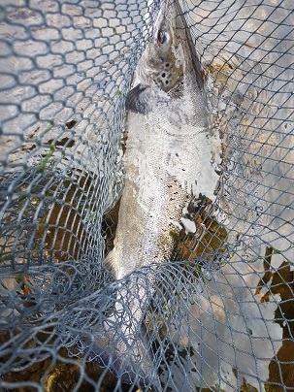
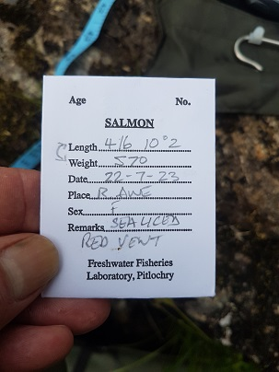
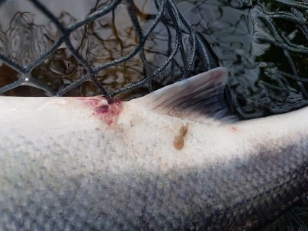
ASSES 2021-23
Adult Salmon Scale Sampling 2023
3rd year of MSS Project
July-September 2023
River Awe - 9 adult salmon sampled
RVD / RSD evident in some fish
River Etive - adult salmon also sampled
Report expected early 2024

Slide 14
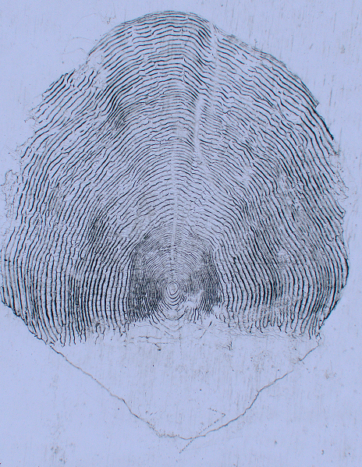
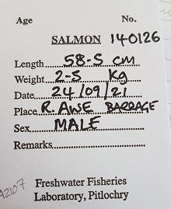
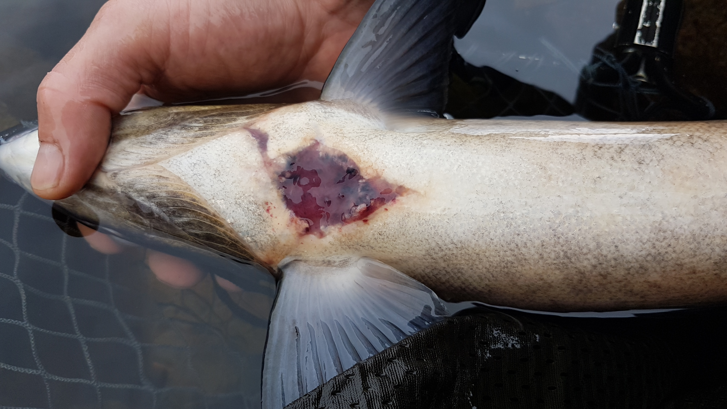
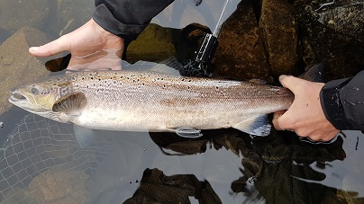
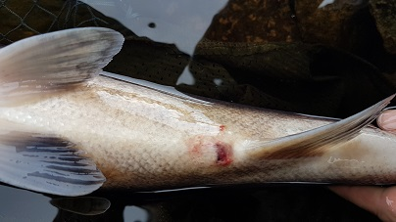
ASSES 2021
Adult Salmon Scale Sampling – Example
Freshwater age – 2 years
Sea age – 1 year
Seal damage
RVD

Slide 15
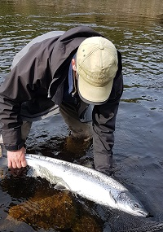
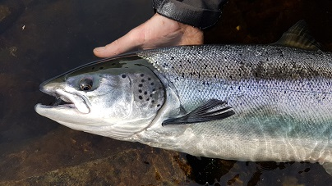
ASSES 2021 Results by Region
1st of 3-year MD Project
West Coast Region – 95 % 1 sea-winter grilse
20 %+ 2 sea-winter on east/North coast
West Coast Region – 60 % 2-year-old smolts/ 40 % 3-year-old smolts
Higher proportion 1-year-old smolts on southern / east rivers

Slide 16
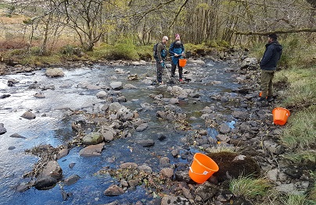
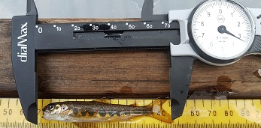
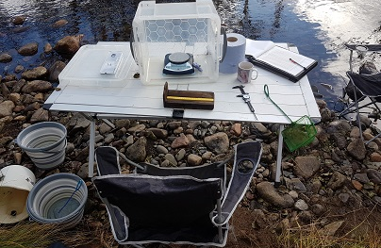
Salmon Nutrient Project – R. Creran
Experimental stocking of eggs from on-grown wild parr
Loss of nutrients due to low adult salmon sea returns
Feeding of marine pellets
Fed & unfed control sites
Electrofishing surveys of fish density / condition
RCIA, AFT & Glasgow Uni.

Slide 17
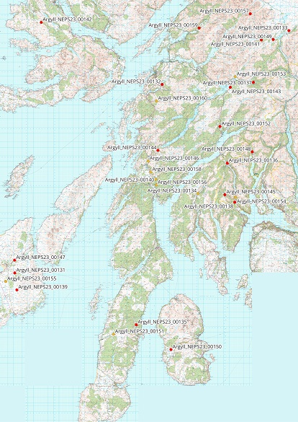
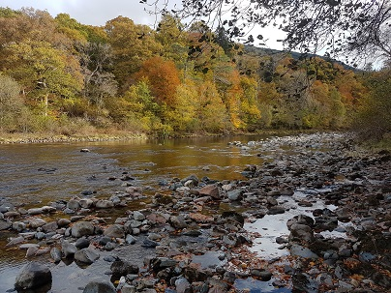
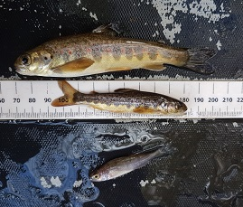
NEPS 2023
30 randomly selected sites throughout Argyll & Isles
Inform Salmon conservation Limits
Provide estimate of fish density against benchmark

Slide 18
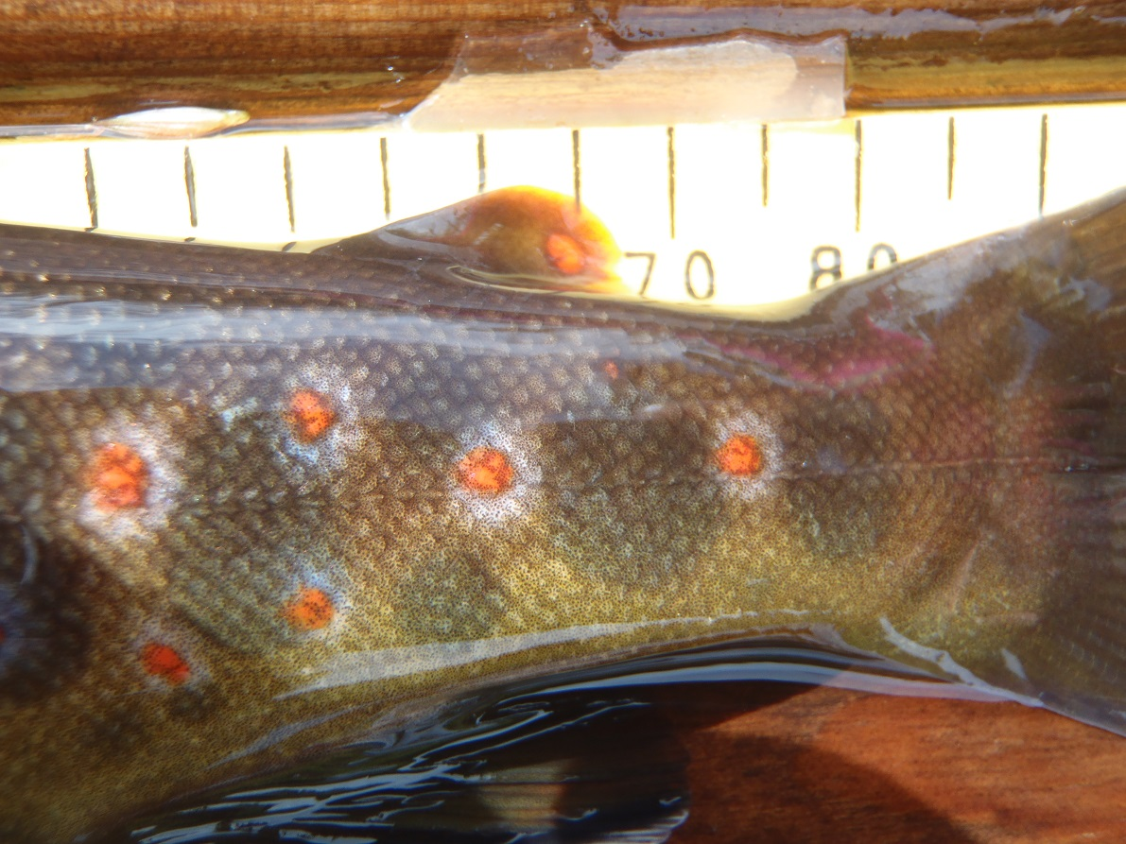
Commercial contracts
Fish Habitat Surveys -
Cour Hydro
Corarsik Hydro
River Forsa
Machrie Water
River Massan
Carraigh Geal Wind Farm
Electrofishing surveys
Barachander wind Farm
Cruach wind Farm
A83 Fish Rescue
Glen Etive Hydro
Carraigh Geal wind Farm
Carradale Water EMP
Sound of Shuna EMP
Glenan Fish Survey
Marine surveys (EMPs)

Slide 19
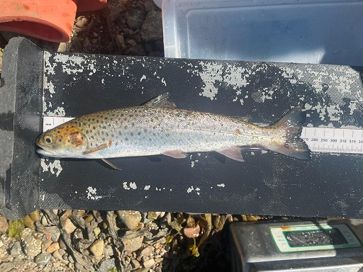
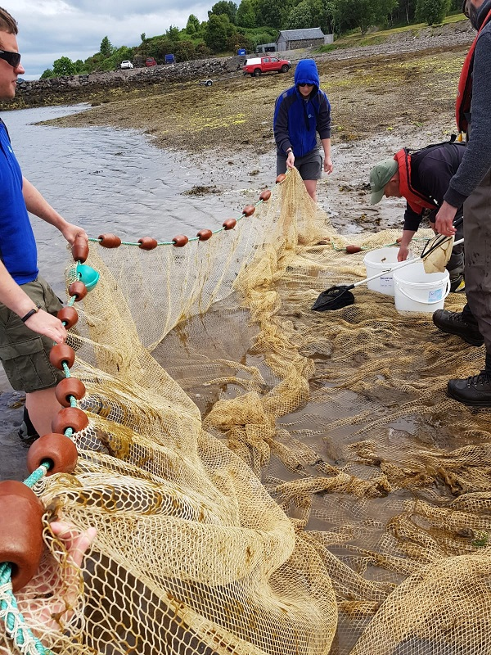
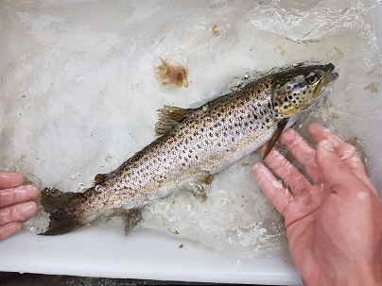
Sea lice / Sea trout Monitoring
11 locations:
Lower Loch Linnhe EMP 3 sites (SSF / FMS)
Sound of Shuna EMP 1 site (Mowi / Kames)
Loch Fyne / W. Mull / W. Arran / Gigha / Ardyne (5 EMP sites BFS)
Carradale EMP (Mowi)
Loch Riddon (FMS)

Slide 20
Thank you for your support
info@argyllfisheriestrust.co.uk

